Slide 1
Ternary Trivia
CSCE A201 Project
Presented by: Hunter, Ryan, James, and Jack
Notes:
Apart from the introduction to the project, the presentation should include the project development strategy or methodology, demonstration or execution screenshots, GitHub details, contributions of each group member, conclusion, references, if any.

Slide 2
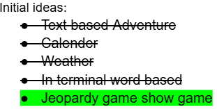
Introduction:
For this project we started with a handful of ideas which ended up combining into a trivia game similar to the format of Jeopardy.
General Idea:
A Trivia game with three teams, where the host shows a prompt, and allocates or subtracts points depending on correct or incorrect answers., with five categories with values 100-500.
Notes:
Hunter

Slide 3
Game Rules:
Host: The host is given the option to decide their own questions or use provided questions, in which case the host can decide if they want the players to answer questions, show points, restart the game, change point values, or exit the program.
Players: Player’s will decide their team’s name or use their own, can decide which a decision for row and column leading to a multiple choice question. The player with the highest points win.

Slide 4
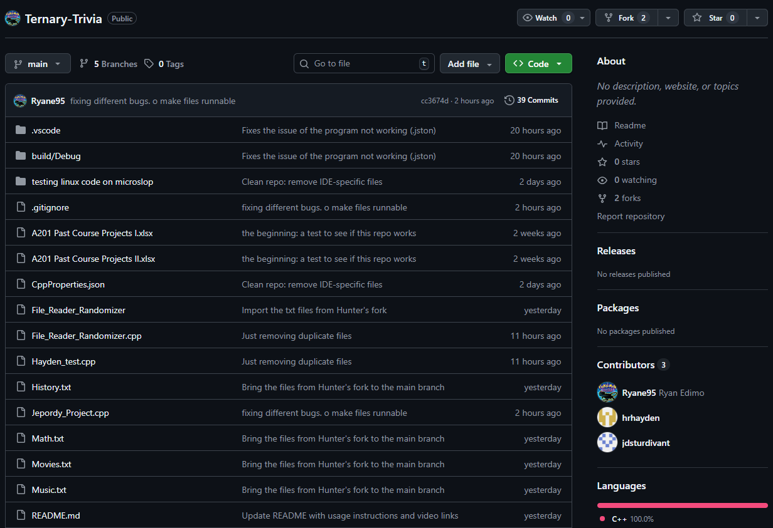
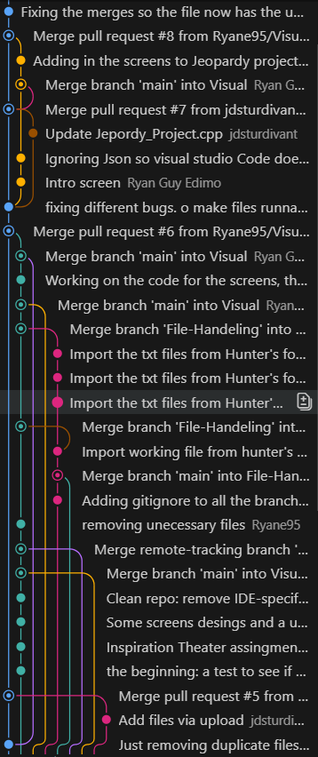
Code Details and GitHub usage:
Mainly used GitHub to make file sharing easier.
Allowed everyone to push, pull, create forks, and pull requests
Made it easiest to get final implementation of code together.

Slide 5
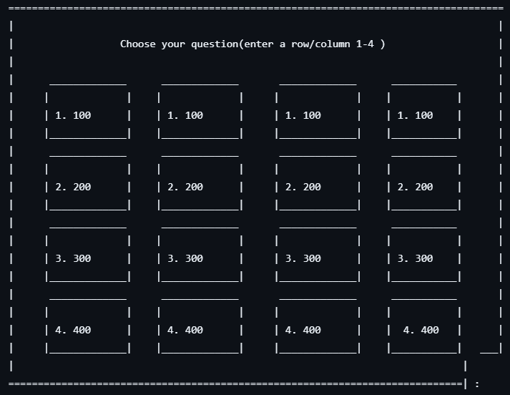
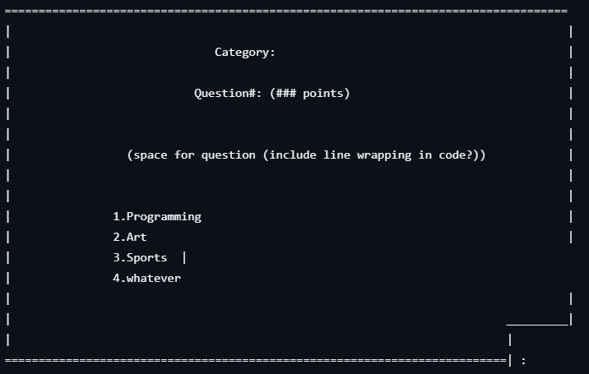
Visuals:
Have a format similar to the Theater terminal/in-line interface
Format with vertical and horizontal lines
Have a five by five grid of points which makes it easy for the user to select a row and column
Have the interface look visually appealing

Slide 6
Editor:
Allows one to add new txt files and edit existing files.
Create new subjects.txt files.
Add new questions for your own custimization.
Searches through existing subjects
shows all questions in selected file
Time efficient(maybe)

Slide 7
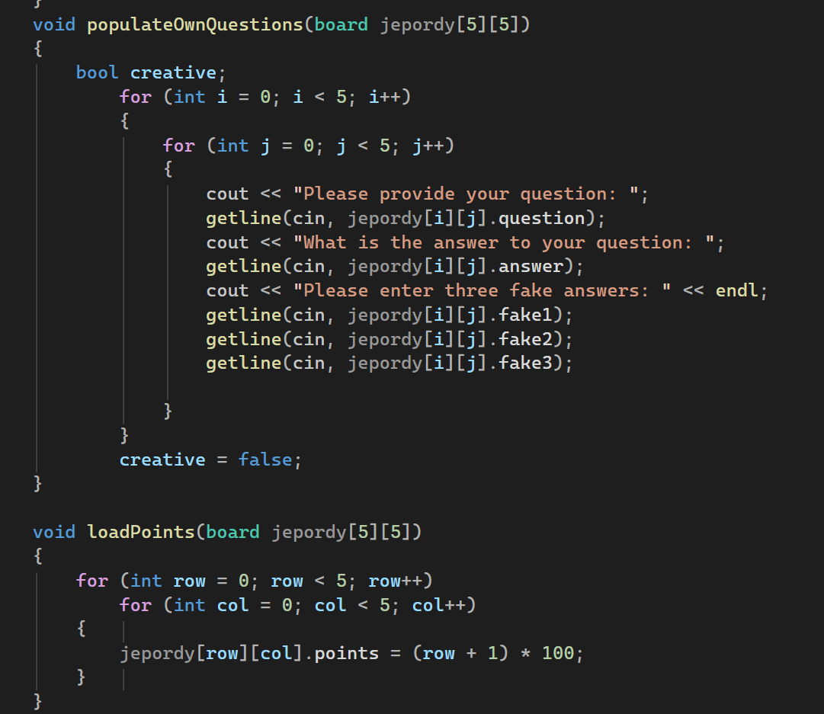
Question and Game Editor:
Prompts host a choice:
Create own questions.
Use predefined questions.
Host can change points:
Host can restart game:
The host can also use preloaded questions.

Slide 8
Game Behavior:
The code uses while loops for input validation.
Prompts user with limited options and a validation loop.
Uses switch cases to important functions.
Prevents illegal choices.
Game rewards player’s for getting the correct answer.
Controls answers into multiple choice.
Keeps track of:
Turn order with no repeating turns.
Point values with correct answers gaining points and incorrect losing points.
Team names
Updates the board for guessed questions.

Slide 9
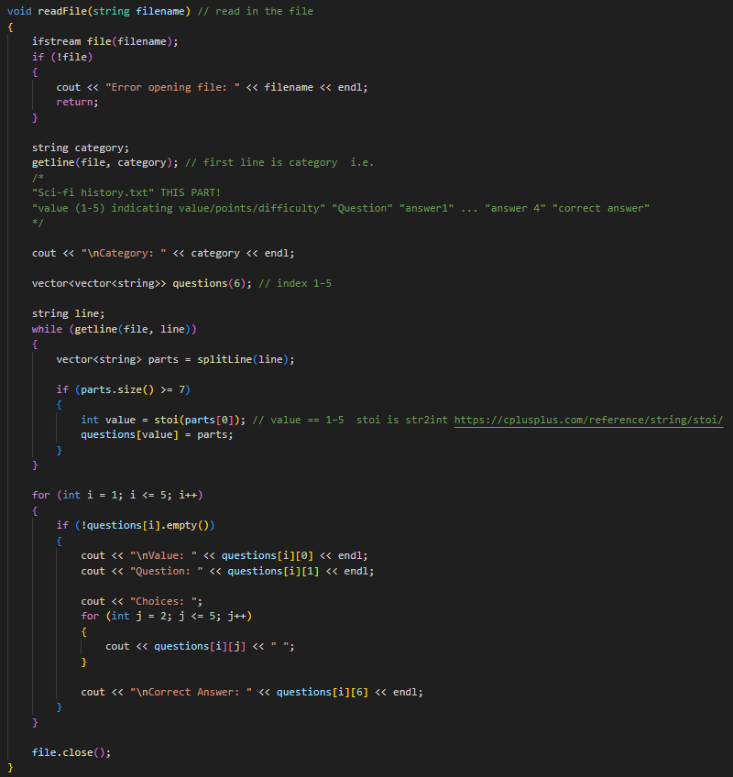
File Handling:
Version 1:
add the ability to read in files
detect the questions indicated value
output to info to identify it’s intended behavior
Notes:
Hunter

Slide 10
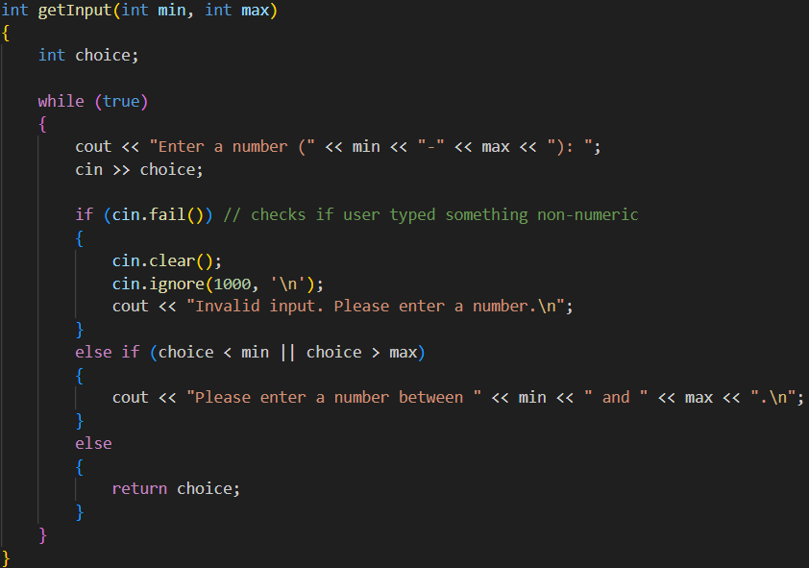
File Handling:
Version 2:
Input validation
added a pause function so the user can review their answer
added test .txt files
Notes:
Hunter

Slide 11
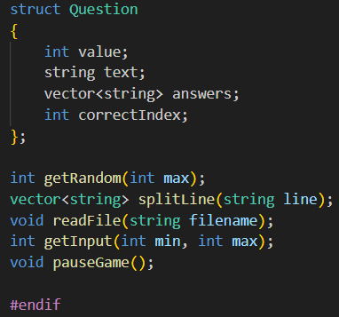
File Handling:
Version 3:
added a main program, a header file, and a implementation file
added a question struct to more easily store question data
Notes:
Hunter

Slide 12
Conclusion:
We were able to get the implement the main game functionality and got the program working
We see this as a success, even though there was more we wanted to accomplish with this.
Future ideas
Add more .txt files
Add music
Add seasonal files using time to tell what season/month it is.
Buzzing in
GUI (Graphical User Interface)
Notes:
Hunter

Slide 13
Sources:
References
cplusplus.com - The C++ Resources Network. (n.d.). Cplusplus.com. Retrieved April 12, 2026, from https://cplusplus.com/. Used for general syntax and included header files; strtok(), vectors, etc. .
csguy. (2019, November 5). cin >> ws vs cin.ignore(numeric_limits::max(), “\n”)? Stack Overflow. https://stackoverflow.com/questions/58705197/cin-ws-vs-cin-ignorenumeric-limitsstreamsizemax-n
GeeksforGeeks. (2019, July 11). Structures in C++. GeeksforGeeks. https://www.geeksforgeeks.org/cpp/structures-in-cpp/

Slide 14
Contributions:
Hunter:
Programming: File input and reading (with subsections), GitHub Usage (Created a repository, pushed & pulled files, created pull requests)
Paper: Abstract, introduction, file handling (with subsections), sources, conclusion, formatting, GitHub Usage
Presentation: Themes, file handling, introduction, GitHub usage, Conclusion, Sources
James:
- Game design: Created the main code, made functions for gameplay.
- Paper: Game Behavior, Rules of the game, sources
- GitHub worked on main, created branches for jeopardy.cpp, created functions for gameplay
- Presentation: Game Rules, Question and Game Editor, Editor Jack:
Programming: Question/Game Editor
Paper: Editor
Presentation: Editor
Ryan:
Programming: Visuals, GitHub help, created the repo, handled all pull requests, created the .README)
Paper: Visuals
Presentation: Visuals

Slide 15
Thank you!
Questions?
Comments?
Concerns?

